Slide 1

Trie Data Structure: An Introduction
SALEEM AMAN (53526)
Notes:
1

Slide 2
What is a Trie and Why Use It?
Definition
Benefits
A trie is a tree-like structure for storing strings by prefixes.
Fast lookup of words by common prefixes
Efficient memory use for related strings
Supports quick autocomplete and spell checks
Notes:
2

Slide 3

Trie Operations: Insert, Search, Delete
1
Insert
2
Search
3
Delete
Add characters one by one, creating nodes as needed.
Follow nodes for each character; success if path exists.
Remove nodes carefully; only if no longer prefix for other words.
Notes:
3

Slide 4
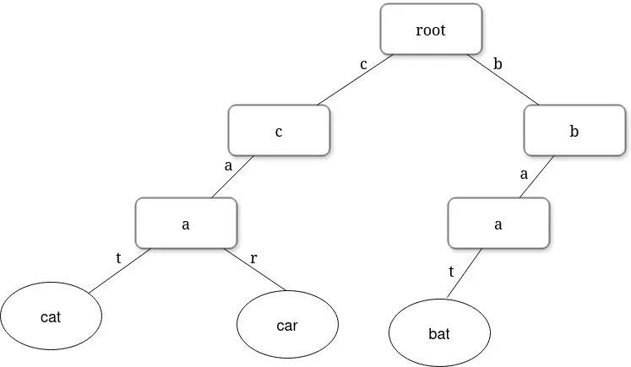
Visualizing Trie Construction with Examples
Step 1: Insert "cat"
Create nodes for c, a, t sequentially.
Step 2: Insert "car"
Reuse nodes for c and a; add new node for r.
Step 3: Insert "Bat"
Build new branch for b, a, t nodes.
Notes:
4

Slide 5


Trie Implementation: Code Walkthrough
Node Structure
Each node holds children and end-of-word flag.
Insert Method
Iterate characters; create nodes if missing.
Search Method
Traverse nodes, check end-of-word status.
Delete Method
Recursively remove nodes, respecting other words.
Notes:
5

Slide 6
Trie Applications: Autocomplete and Spell Check
Autocomplete
Spell Check
Predicts words based on typed prefixes
Finds valid word matches for mistyped entries
Improves typing speed and user experience
Suggests corrections efficiently
Notes:
6

Slide 7

Conclusion: Advantages, Disadvantages, and Use Cases
Advantages
Disadvantages
Fast prefix queries and memory efficiency for large datasets.
Can use more memory for small datasets; complex implementation.
Use Cases
Auto suggestions in search engines
Text editors and input validation
IP routing and dictionary storage
Notes:
7

Slide 8
Thank You
Notes:
7

